Slide 1
Machine Learning
Basics

Slide 2
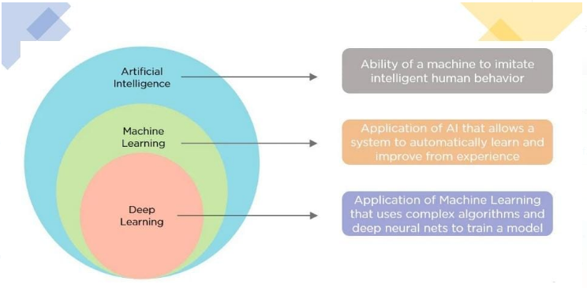
Artificial Inteligence vs Machine Learning vs Deep Learning

Slide 3
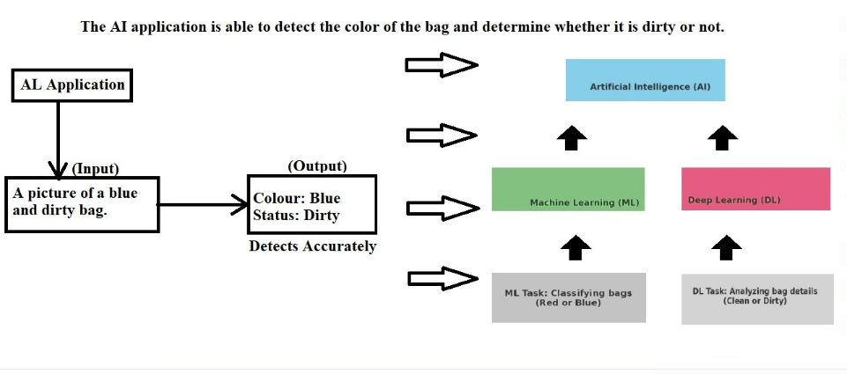
Artificial Inteligence vs Machine Learning vs Deep Learning
Example 1:-

Slide 4
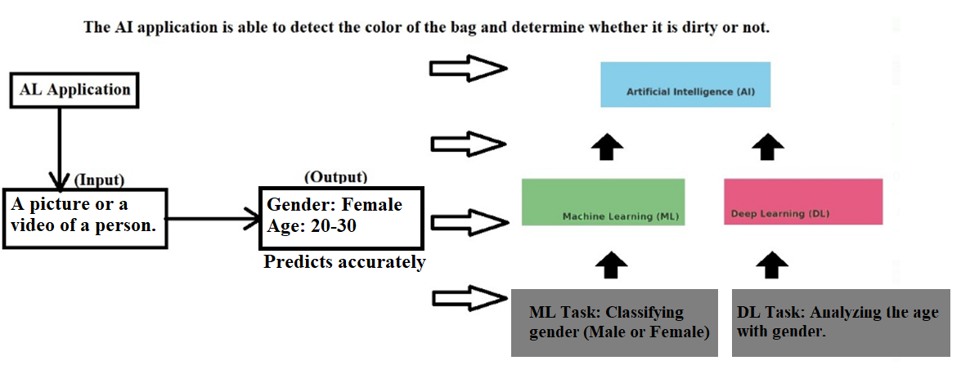
Artificial Inteligence vs Machine Learning vs Deep Learning
Example 2:- Gender and Age predition.
Link:- Age-Gender-Detector – main.py - 30 July 2024 (loom.com)

Slide 5
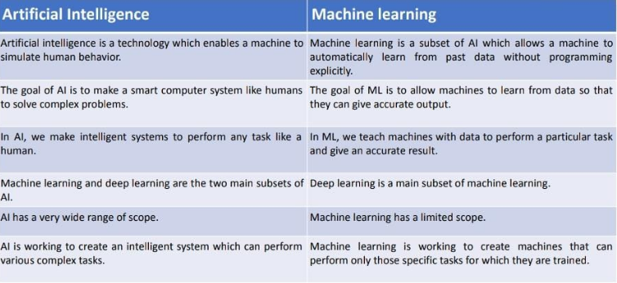
Difference between Artificial intelligence and Machine Learning.

Slide 6
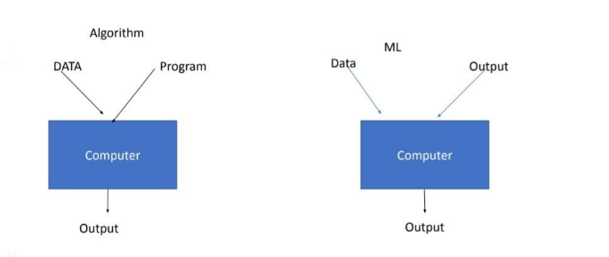
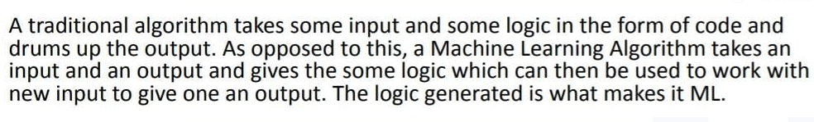
Machine Learning Vs Normal Algorithm

Slide 7


Slide 8
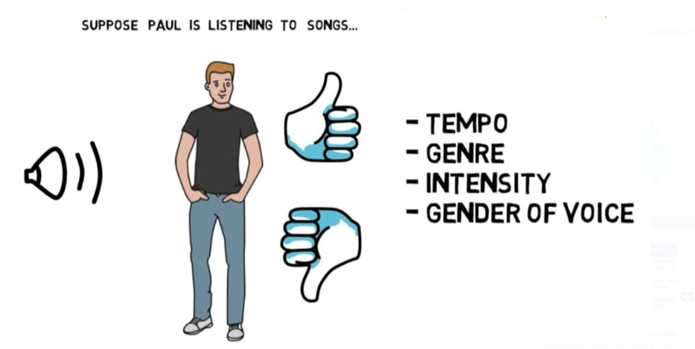

Slide 9
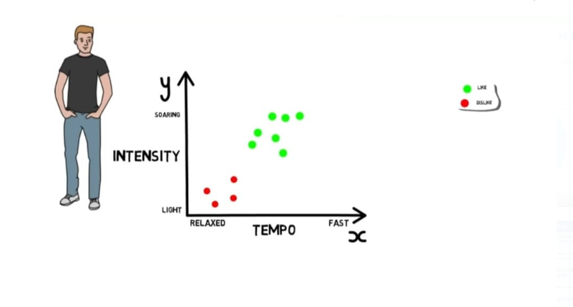

Slide 10
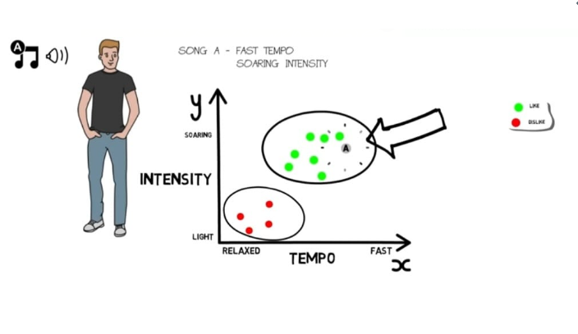

Slide 11
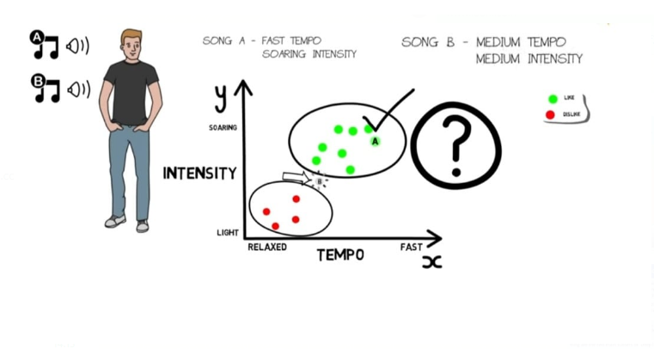

Slide 12
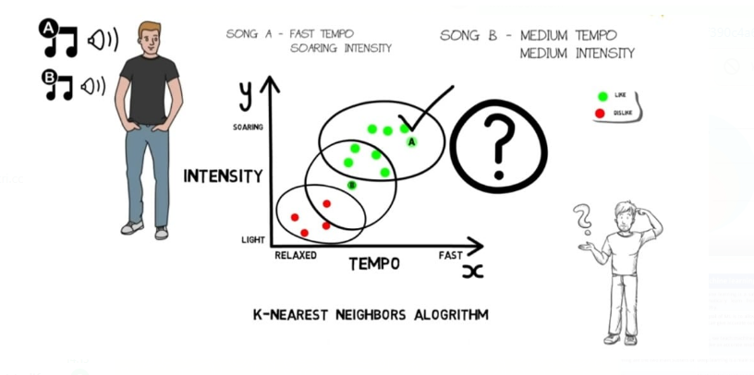

Slide 13
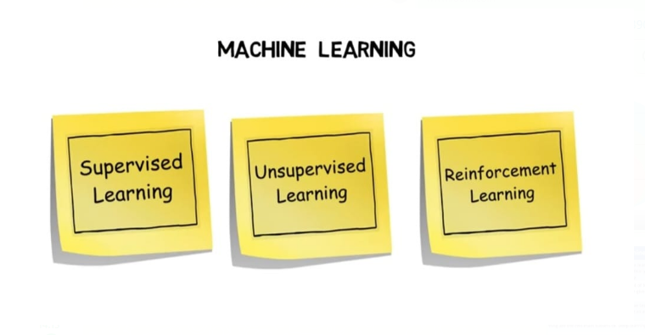

Slide 14
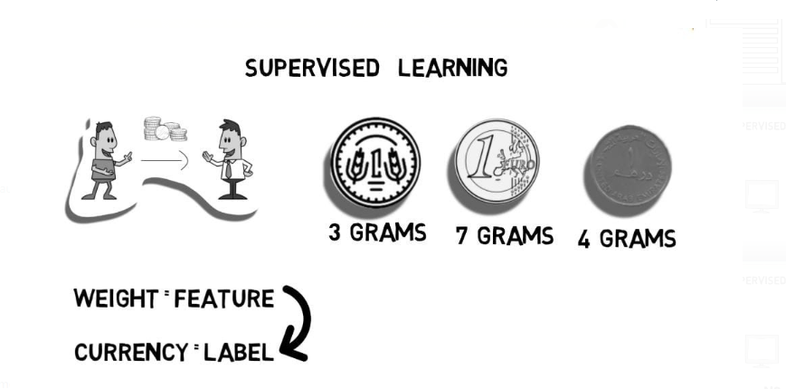

Slide 15
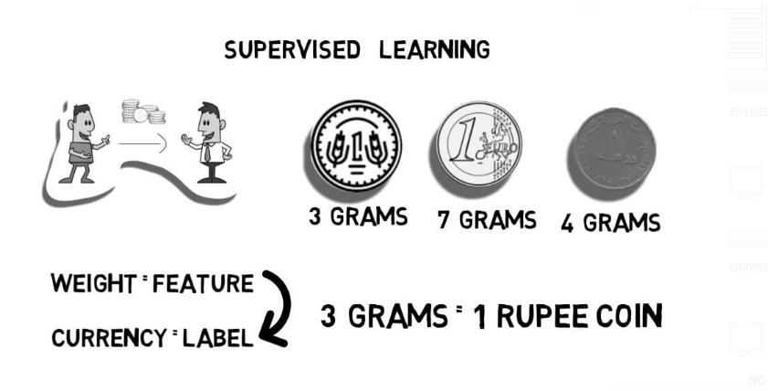

Slide 16
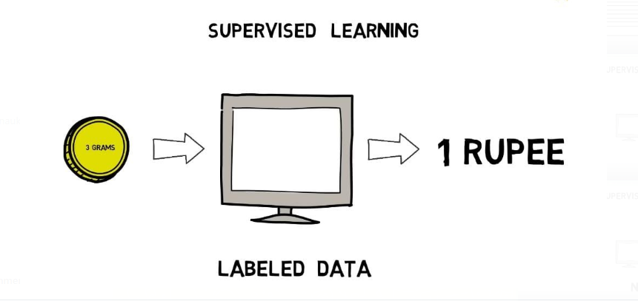

Slide 17
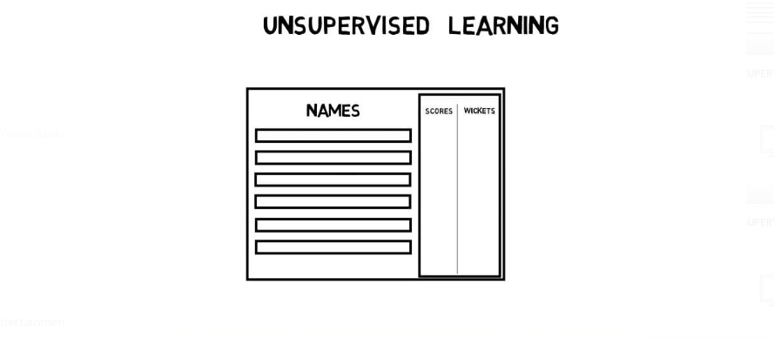

Slide 18
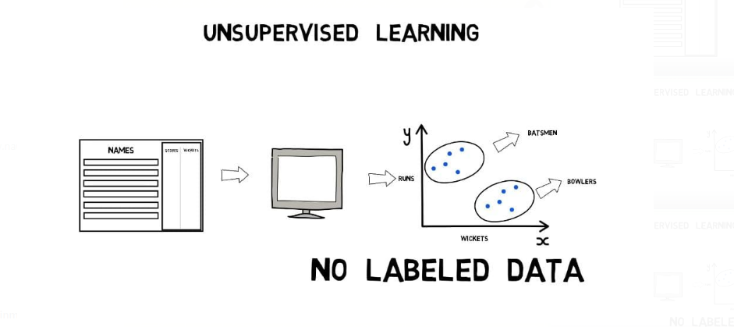

Slide 19

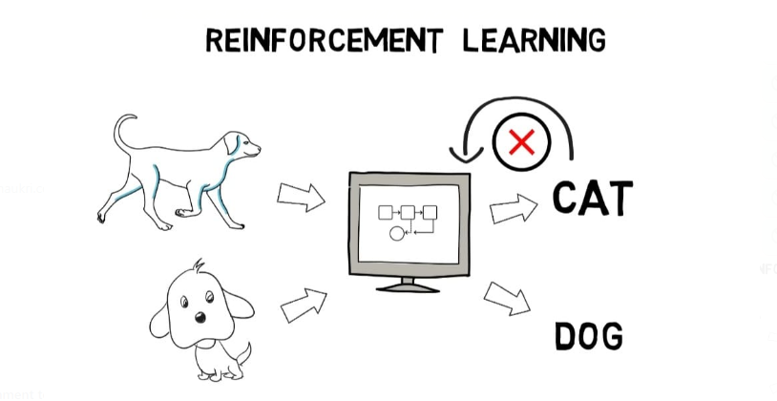
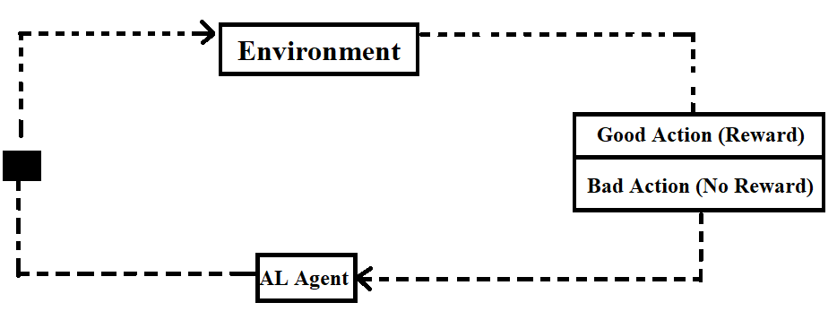

Slide 20
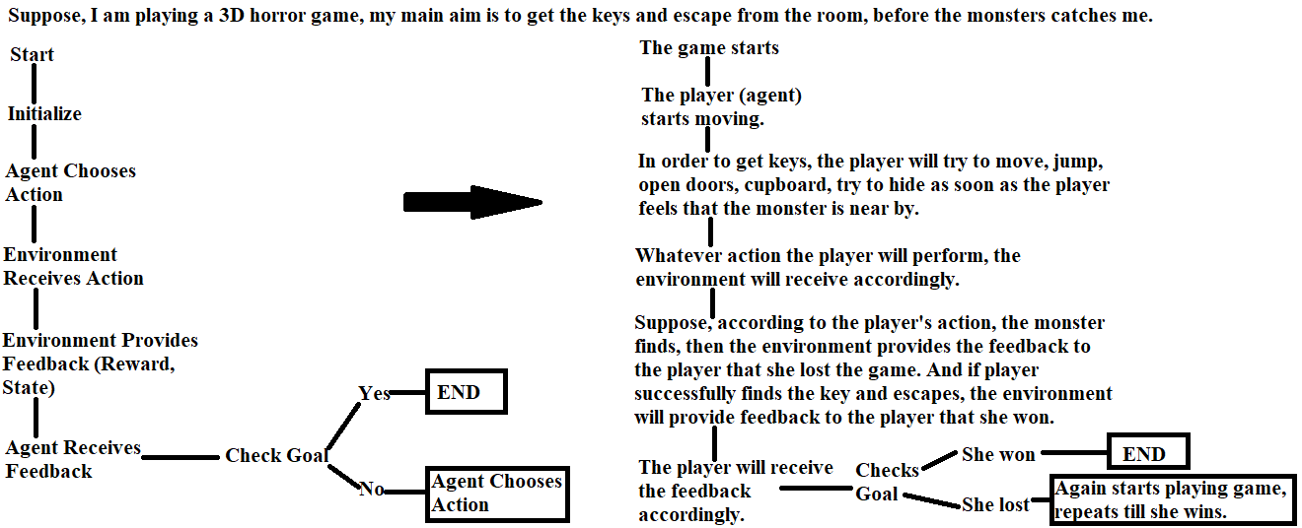

Slide 21
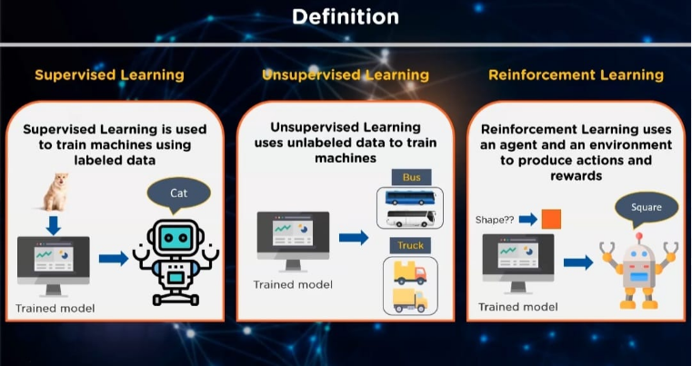

Slide 22
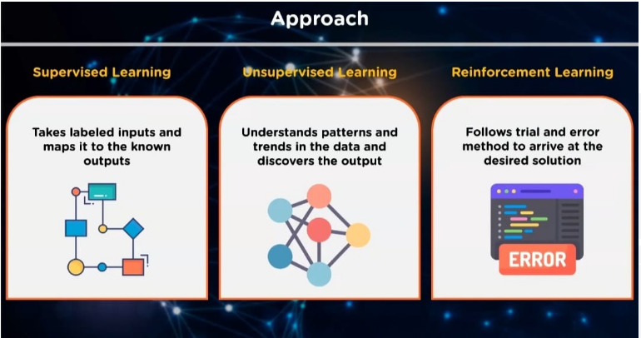

Slide 23
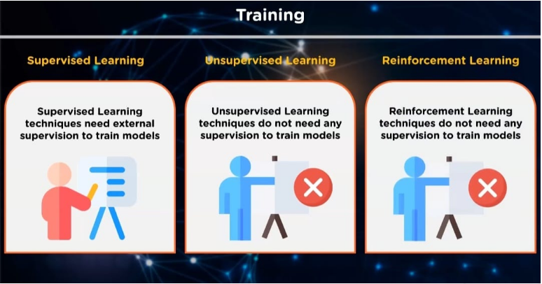

Slide 24
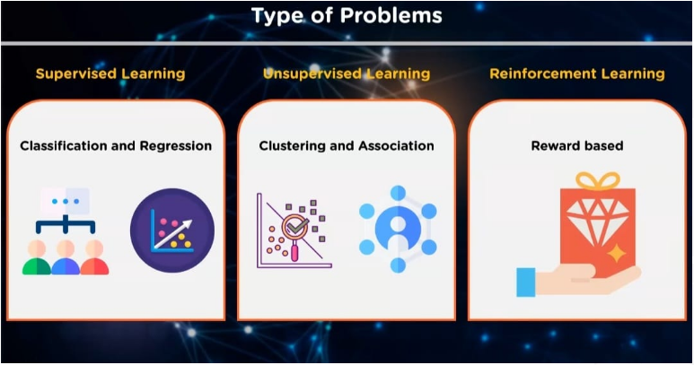

Slide 25
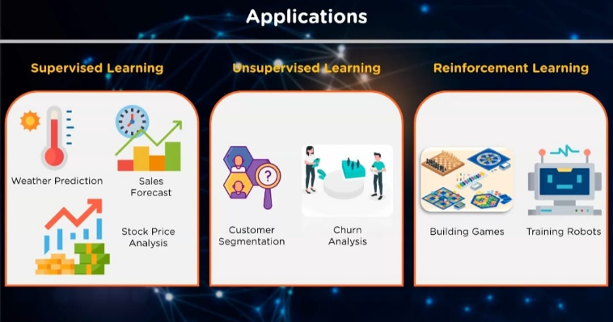

Slide 26
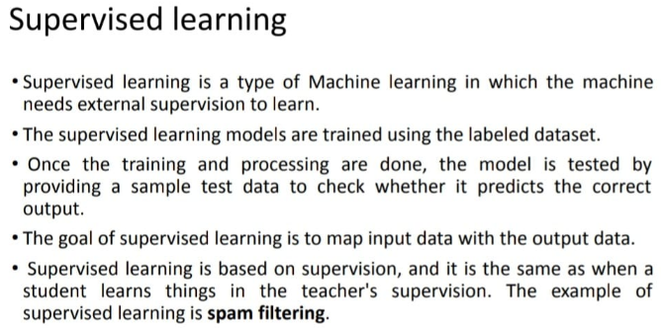
Notes of Supervised, Unsupervised and Reinforcement Learning

Slide 27
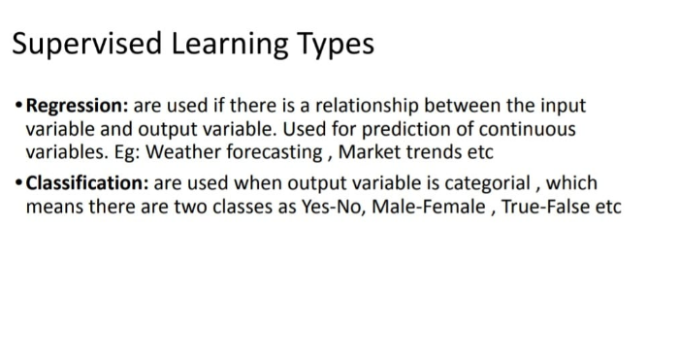

Slide 28
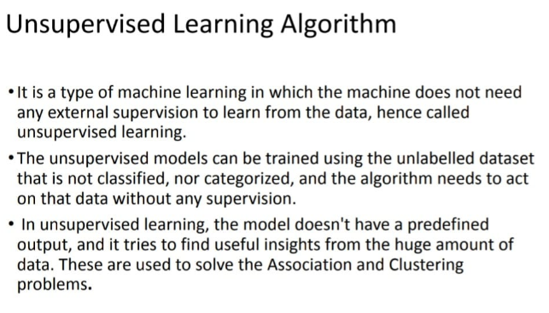

Slide 29
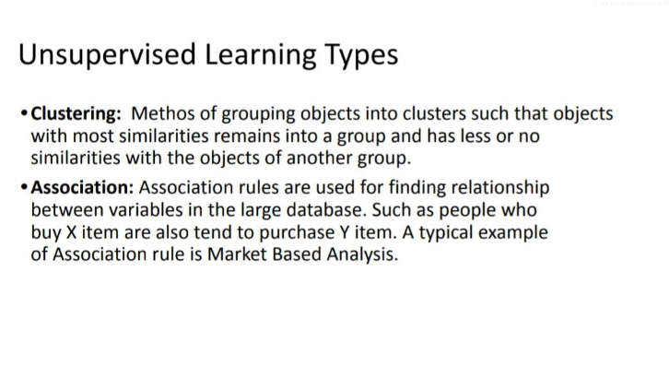

Slide 30
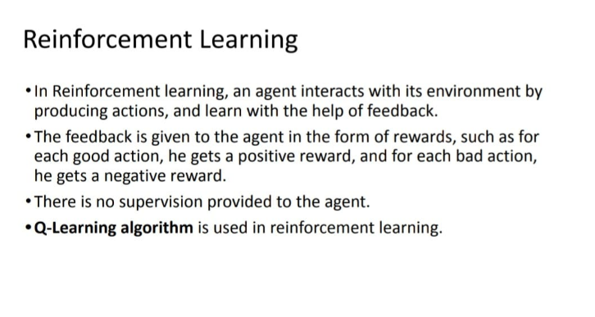

Slide 31
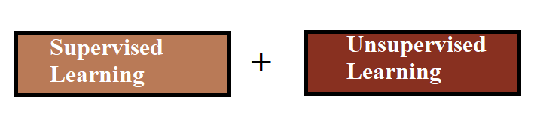
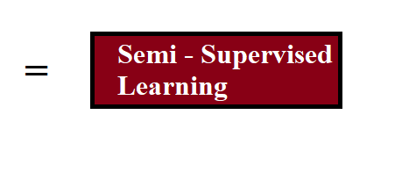
Semi-Supervised Learning

Slide 32
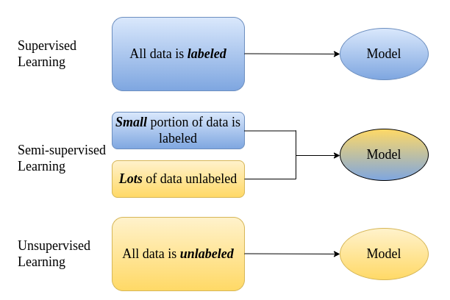
Semi-Supervised Learning

Slide 33
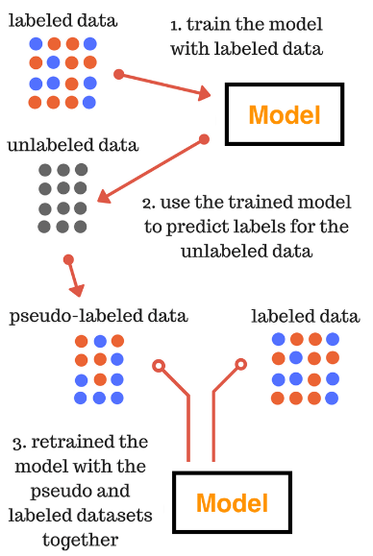

Techniques Used in Semi-Supervised Learning:
1. Pseudo-labeling
Steps:-
Train a model with labelled data.
Use the trained model to predict labels for the unlabeled data, which creates pseudo-labeled data.
Retrain the model with the pseudo-labeled and labeled data together.

Slide 34
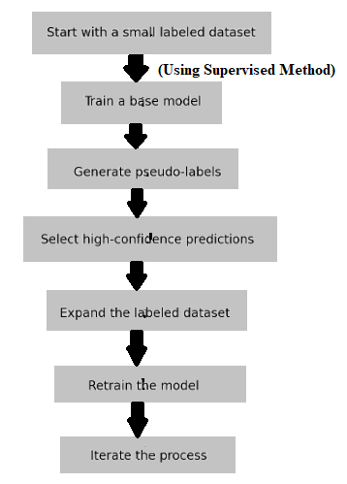
Techniques Used in Semi-Supervised Learning:
2. Self-Training
Steps:-
1. Start with labeled data: Use images labeled as cats and dogs.
2. Train base model: Train with supervised methods on labeled data.
3. Generate pseudo-labels: Predict labels for unlabeled data using the trained model.
4. Select high-confidence predictions: Keep predictions with over 80% confidence.
5. Expand labeled dataset: Add high-confidence pseudo-labels to the labeled data.
6. Retrain the model: Train the model again using the expanded dataset.
7. Iterate the process: Repeat the process multiple times (e.g., 10 iterations).

Slide 35
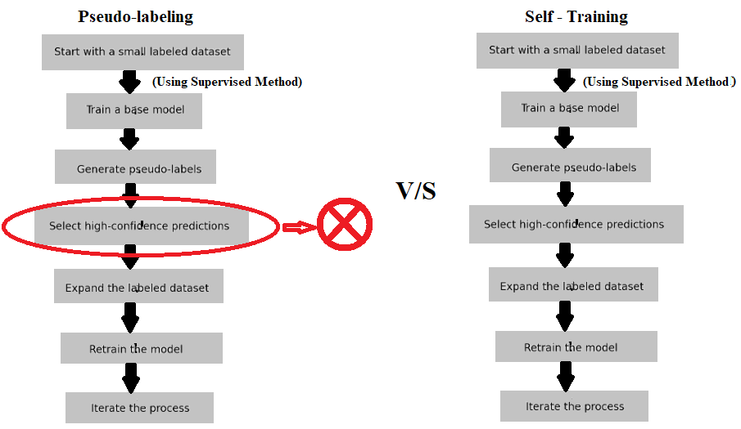
Techniques Used in Semi-Supervised Learning:
Pseudo-Labeling:
All Predictions Used: Imagine you have a model that guesses whether a picture is a cat or a dog. With pseudo-labeling, you use all the guesses the model makes, even if the model isn't very sure.
One-Time Process: You do this once and use those guesses to help the model learn better.
Self-Training:
Only Sure Predictions Used: Now, think of the same model. With self-training, you only use the guesses where the model is very sure (like 80% sure it's a cat or a dog).
Repeated Process: You repeat this step several times, each time using the very sure guesses to help the model learn better and better.

Slide 36
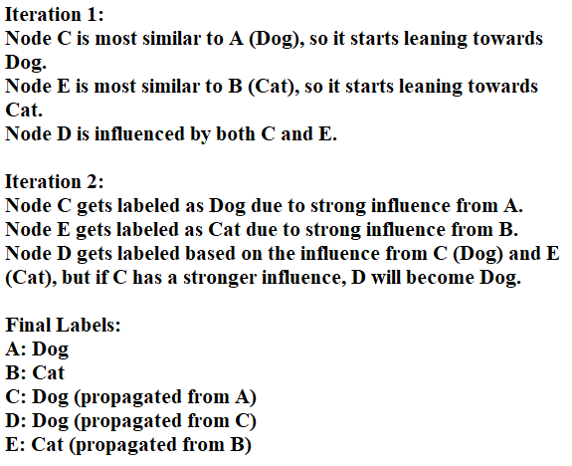
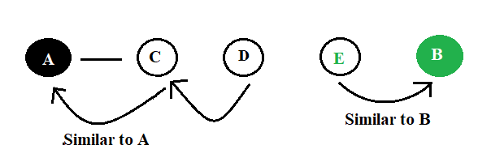
Techniques Used in Semi-Supervised Learning:
3. Label Propagation
Suppose;
Nodes: A (Dog), B (Cat), C (Unlabeled), D (Unlabeled), E (Unlabeled)
Graph: A -- C -- D -- E -- B (Labeled nodes are A and B , Unlabeled nodes are in C, D and E).

Slide 37
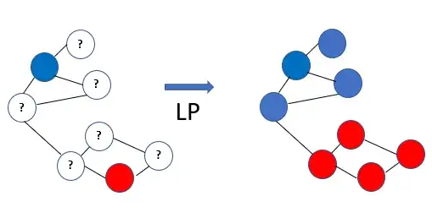
3. Label Propagation

Slide 38
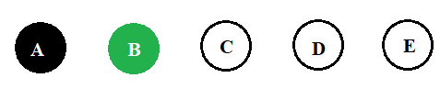
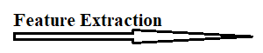
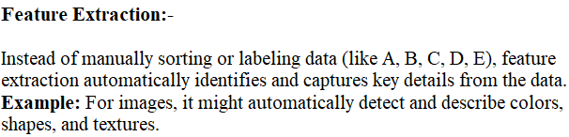
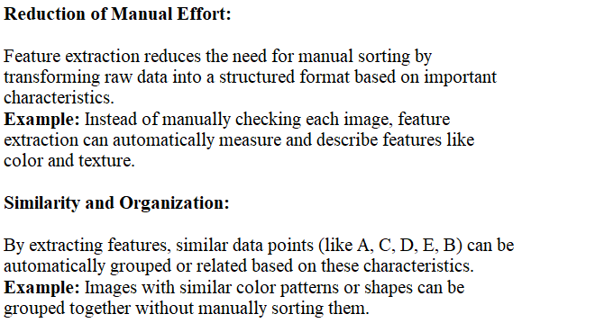
3. Label Propagation

Slide 39
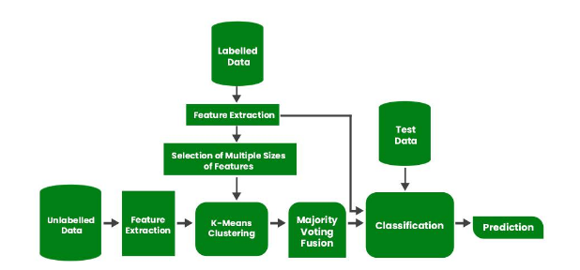
Flow Chart of Semi-Supervised Learning

Slide 40
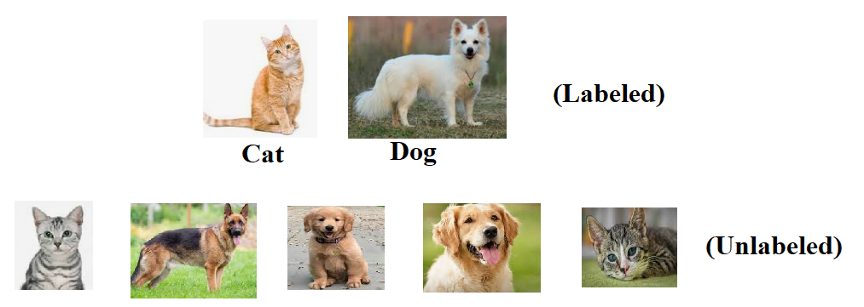


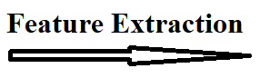
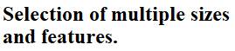
Flow Chart of Semi-Supervised Learning (For Example)

Slide 41
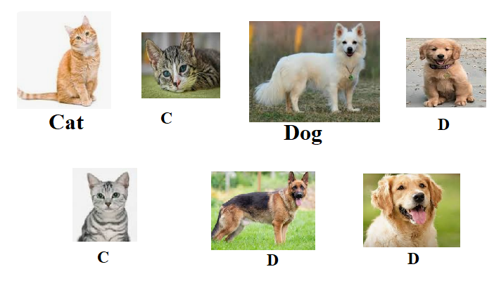
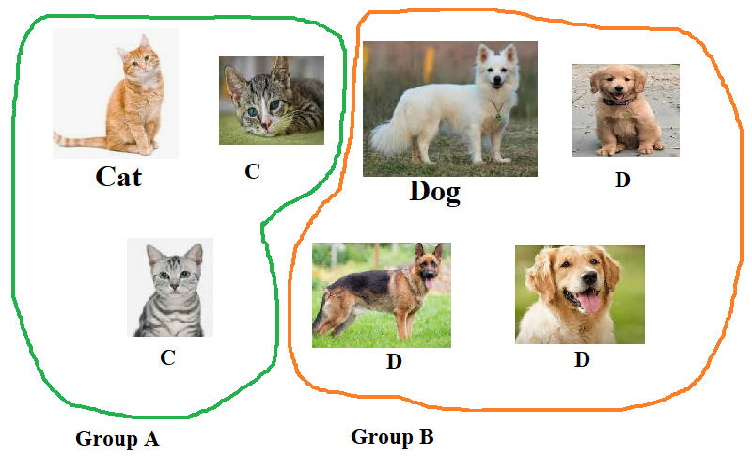
After feature extraction:- (Before) (After)
Implementing K means clustering:-

Slide 42
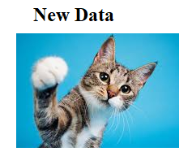
Suppose, I got a new data and I don’t know in which group, the new data will belong to.

Slide 43

Here comes the majority voting step:-
Step 1: Use multiple models to classify a new data point.
Suppose you’re using three different machine learning models to classify a new data point:
Model 1 (Decision Tree): Predicts Group A.
Model 2 (k-NN): Predicts Group B.
Model 3 (K-Means Clustering): Predicts Group A.
Majority Voting:
Group A: 2 votes
Group B: 1 vote
The new data point is classified into Group A because it received the majority of votes.,so the new data is classified as a “cat”.

Slide 44

Supervised Learning Algorithms

Slide 45

When to use Classification and Regression?

Slide 46

Supervised Learning (Classification):-

Slide 47

Binary classifications:- Note:- Logistic Regression and Support Vector Machines algorithms are natively designed for binary classifications.

Slide 48

Multi-Class Classifications:- Most of the binary classification algorithms can be also used for multi-class classification.

Slide 49

But, suppose we are using an algorithm such as as logistic Regression that do not support multi-class classification by default.
In that case;
1. One-vs-One (OvO) Approach:-
This method turns a multi-class problem into several binary problems.
If we have a 3-class classification, we will have three pairs of labels, thus three classifiers, as shown below:- (for N classes, you need N(N−1)/2 classifiers)

Slide 50

2. One-vs-Rest (OvR) Approach:-
i) Example 1
Imagine you have three different kinds of fruits: apples, bananas, and cherries. You want a machine to learn to recognize these fruits. The One-vs-Rest approach is like teaching the machine three separate lessons:
First Lesson: "This is an apple" vs. "This is not an apple" (which means it could be a banana or a cherry).
Second Lesson: "This is a banana" vs. "This is not a banana" (which means it could be an apple or a cherry).
Third Lesson: "This is a cherry" vs. "This is not a cherry" (which means it could be an apple or a banana).
ii) Example 2

Slide 51


Multi Level Classifications:-

Slide 52

Decision Tree (Supervised-Classification):-

Slide 53

Suppose there is a candidate who has a job offer and wants to decide whether he should accept the offer or Not. So, to solve this problem, the decision tree starts with the root node (Salary attribute by ASM). The root node splits further into the next decision node (distance from the office) and one leaf node based on the corresponding labels.

Slide 54

KNN (Supervised-Classification):-

Slide 55

KNN (Supervised-Classification):-

Slide 56

Support Vector Machines (Supervised-Classification):-
Lets Recap The Types of Classification:-
1. Binary Classification:-

Slide 57
Support Vector Machines (Supervised-Classification):-
2. In multi-class classification:- Binary classification deals with exactly two classes, whereas multi-class classification deals with three or more classes. The model is trained to classify inputs into one of these multiple classes, but, suppose we are using an algorithm such as as support vector machines or logistic Regression that do not support multi-class classification by default, we can use two approaches.
i) One-vs-One (OvO) Approach:-
For example, with Flight, Truck, and Boat, you train:
Flight vs. Truck
Flight vs. Boat
Truck vs. Boat
If we have:
Flight vs. Truck: Predicts Truck
Truck vs. Boat: Predicts Truck
Flight vs. Boat: No prediction/Predicts Flight/Predicts Boat
In our case, 2 classifiers that made predictions said Truck, so Truck is the final decision.
If some classifiers can’t make a prediction (like Flight vs. Boat in your example), they just don’t count. The decision is made based on the majority of the classifiers that do provide a prediction.

Slide 58

Support Vector Machines (Supervised-Classification):-
ii) One-versus-Rest (OvR) Approach:-
Each classifier is trained to distinguish between one class and the rest. For example, if there are three classes (A, B, and C), we train:

Slide 59

Support Vector Machines (Supervised-Classification):-

Slide 60
Given diagram is an example of Binary Classification.

Slide 61

Support Vector Machines (Supervised-Classification):-
Now, lets come to multi-class classification.

Slide 62


Support Vector Machines (Supervised-Classification):-
Lets use One vs One approach:-
i) Circle vs Square ii) Circle vs Triangle

Slide 63

iii) Square vs Triangle
Result:- i) Circle vs Square: Predicts Circle
ii) Circle vs Triangle: Predicts Circle
iii) Square vs Triangle: Predicts Square / Predicts Nothing
Here, 2 classifiers that made predictions said Circle, so Circle is the final decision.

Slide 64


Support Vector Machines (Supervised-Classification):-
Now, lets use One-versus-Rest (OvR) Approach:-
i) Circle vs Not Circle ii) Triangle vs Not Triangle

Slide 65

iii) Square vs Triangle
Result:- i) Circle vs Not Circle: Predicts “Circle”, high confidence that the data point is Circle.
ii) Triangle vs Not Triangle: Predicts “Not Triangle”, high confidence that the data point is Not Triangle.
iii) Square vs Not Square: Predicts “Not Square”, high confidence that the data point is Not Square.
So, “Circle” is the final decision.

Slide 66

Support Vector Machines (Supervised-Classification):-
Maximal Margin Hyperplane:-

Slide 67

Support Vector Machines (Supervised-Classification):-
Non – Linear SVM & Kernel Function-

Slide 68

Non – Linear SVM & Kernel Function-
The picture shown as known as “misclassification”, here we cannot use a straightline or hyperplane to classify circles and stars. Here we have to use non-linear svm technique. In Linear SVM, we use straight line or hyperplane, in non-linear svm, we use kernel trick.

Slide 69

Non – Linear SVM & Kernel Function-
Kernel function takes the low dimentional feature space to higher dimentional feature space. Once the data is mapped into this higher-dimensional space using the kernel function, the SVM algorithm finds a hyperplane that can separate the classes.

Slide 70

Logistic regression (Supervised-Classification):-

Slide 71

Logistic regression (Supervised-Classification):-
Remember that linear regression requires that the dependent variable, the one we put on the y-axis, should have a continuous scale.
The equation of Linear Regression is Y=b0+b1X
In this diagram, as shown, we have collected eight individuals at different ages and measured their PSA levels.

Slide 72

This person is 82 years old, and has a PSA concentration of about 3.4 Mg/L.

Slide 73

By fitting the linear regression model to the data, we can estimate the parameters; bo is the intercept, and b1 is the slope.

Slide 74




Slide 75


i) ii)
iii) iv)

Slide 76


Now, lets come to logistic Regression:-
Logistic regression is a type of model which is used to predict the probability of a binary outcome (Yes or No).
We use a categorical outcome, like "yes" or "no," on the Y-axis and a predictor value on the X-axis. We set a threshold, usually 0.5, to decide the outcome. If the probability calculated by the model is more than 0.5, you classify it as "yes"; if it's less than 0.5, you classify it as "no.“

Slide 77

Logistic regression uses the sigmoid function (s- shaped curve) to model the probability of the outcome. This curve transforms the output of the linear equation into a probability between 0 and 1.
We calculate the probability using the logistic regression formula:-
Using a threshold (usually 0.5), you classify the outcome based on the calculated probability (by using the formula. If the probability is greater than 0.5, you classify it as "1" (e.g., "has cancer"). If it is less than 0.5, you classify it as "0" (e.g., "does not have cancer").

Slide 78

Now, Suppose we have the following data where the variable of y-axis has only two categories. The variable on the y-axis represents if someone has prostate cancer or not.

Slide 79

Lets change “Yes” to 1, and “No” to 0.

Slide 80




Now, if we try to fit a straight line to this data, it will result in a very bad fit.
For this type of data, it seems better to fit an s-shaped curve that can only take values between 0 and 1. S-shaped curve, also known as the sigmoid function, is used in logistic regression to calculate probabilities. Here e is the Euler’s number, which is equal to 2.718. b0 and b1 are the parameters that we like to estimate, similar we do in linear regression.

Slide 81


Now, we will use the following data set to see how the y-axis can be seen as a probability between 0 and 1. We will also see, how the s shaped curve fits in this example.
Lets cut this plot into 6 pieces. Now, in PSA range between 0 and 1, we have only healthy individuals, which means, we have 0% of individuals with prostate cancer. In range between, 1 and 2, 20% have cancer. In range between 2 and 3, 50% have cancer, same goes for range between 3 and 4, and 4 and 5.

Slide 82


Now, we can add a point in this plot that shows that with a PSA level of 0.5, which is the midpoint in the first range, we have no prostate cancer patients.
Then we add the point for the second range, where 20% of the individuals have prostate cancer.

Slide 83


Like this, we plot for other ranges.
If we fit the logistic curve to these data points, the curve now fits very well.

Slide 84


We can now use this curve to estimate the proportion that has prostate cancer in our sample. The curve can therefore be seen as an estimate of the proportion of individuals that have prostate cancer given a certain PSA.
This curve, which is like a s shaped is indeed a sigmoid curve.

Slide 85

Suppose, in this graph only, the predicted probability that a person with a PSA concentration of 3, has prostate cancer.
Now. Lets see if the person with PSA 3 has cancer or not with the help of the given equation. By using a statistical software, we can compute the optimal values for b0 and b1 that give us a good fit to the data. Lets say, given b0=-5and b1=2. As discussed earlier, value of e is 2.718.

Slide 86

Now, in this equation, p(cancer)=0.73, which means there is a 73% chance of cancer.

Slide 87

Now, lets use another value of b0 and b1. By using statistical software, we got to know that the b0 = -5.75 and b1=2.75.

Slide 88

Now, by using the formula, we got the probability.

Slide 89


In Logistic regression:-
Probability is the chance of the event occurring.
Odds are the ratio of the probability of the event occurring to the probability of the event not occurring.

Slide 90

Now, coming to the example;

Slide 91

This is the result after calculating the odds for other rows as well, using the same equation to convert the probabilities into odds.

Slide 92

After gettings odds, lets calculate logged odds.

Slide 93



Slide 94


Slide 95

Now let’s plot these logged odds so that we can see how the logged odds change over different PSA levels.
The logged odds seem to follow a straight line. We can now fit a straight line to the data points.

Slide 96

Remember that we used the following equation to fit the logistic curve to the data, when the y-axis was expressed as a probability.

Slide 97


Formula of Logit / In(Odds) =
We can transform the equation so that the left-hand side is expressed as logged odds instead of probability.

Slide 98



Suppose, I want to find, if the person with PSA level 3 is falling in 1(yes) category or 0(No) category via logit function.
Solution:-In(odds)= -5.75+2.25(3) = 2.50
In(odds)=2.50; also known as Logit(p) = 2.50;
In(2.50)

Slide 99

Now, the probability is 0.9, is it falling in ‘yes’ category or ‘no’ category.

Slide 100

Why Logit function is used if we can simple find in which category the person belongs to by using probability function?
Ans:- As shown in the figure, we use this equation for the straight line. A straight line in logistic regression makes it easier to see and interpret how a change in PSA levels impacts the risk of cancer. If the line slopes up, it means higher PSA levels increase cancer risk.
By fitting a straight line, we can predict outcomes (cancer or no cancer) more accurately for new, unseen data. We know exactly how much each unit increase in PSA raises the risk because of the line’s slope.
-5.75: This is the intercept of the line. It's the starting point on the vertical axis when PSA is zero. It represents the base level of the logged odds of having cancer when PSA levels are zero.
2.75: This is the slope of the line. It shows how the logged odds of having cancer increase with each unit increase in PSA. A slope of 2.75 means that for each increase of 1 unit in PSA, the logged odds of having cancer increase by 2.75.

Slide 101

Naïve Bayes (Supervised Classification):-
Before coming to “Naïve Bayes”, let’s understand Bayes’ theorem.
.

Slide 102


Slide 103


Slide 104
Now coming to Naïve bytes:-
Imagine guessing the type of a mystery fruit:
You Have Clues:
1. The fruit is red.
2. The fruit is round.
You Know Facts:
Many red fruits are apples.
Many round fruits are apples too.
Combine the Clues:
Naïve Bayes uses these facts to guess: If a fruit is red and round, it’s probably an apple.
How It Works:
Learn from Examples: It looks at a lot of fruits and learns patterns, like "red fruits are often apples."
Make a Guess: When you see a new fruit, it uses what it learned to guess if it’s an apple.
Why It’s Called “Naïve”?
It’s "naïve" because it assumes that each clue (red color and round shape) is separate and doesn't affect each other, which isn’t always true but still helps make good guesses.
So, Naïve Bayes is just a way of guessing based on patterns you’ve learned from examples!

Slide 105
Difference between Bayes' Theorem and Naïve Bayes
Bayes' Theorem:-
What It Is: A formula to find the chance of something happening based on what you already know.
Example: If you know the chance of rain and that it’s cloudy, Bayes' Theorem helps you find the chance of rain given that it’s cloudy.
Naïve Bayes:-
What It Is: A way to classify things based on multiple clues, assuming that each clue is independent.
Example: If you’re trying to figure out if a fruit is an apple, Naïve Bayes uses clues like color and shape and assumes each clue doesn’t affect the others.
So, Bayes' Theorem is a general idea, and Naïve Bayes is a specific way to use that idea for guessing or classifying things.

Slide 106
Working of Naïve Bayes' Classifier:
Suppose we have a dataset of weather conditions and corresponding target variable "Play". So using this dataset we need to decide that whether we should play or not on a particular day according to the weather conditions. So to solve this problem, we need to follow the below steps:
Steps to Solve-
Look at Past Data: Check how often people played or didn’t play for each type of weather (like a person played in sunny, a person didn’t play in rainy, etc).
Calculate Chances: Find out the probability of playing or not playing for each weather condition based on past data.
Use Bayes' Theorem: Combine what you know about the current weather with the probabilities from past data to make a decision about playing.

Slide 107

Problem: If the weather is sunny, then the Player should play or not?
Solution:To solve this, first consider the below dataset:

Slide 108


Slide 109






Slide 110

Supervised Learning (Regression):-
Suppose there is a marketing company A, who does various advertisement every year and get sales on that. The below list shows the advertisement made by the company in the last 5 years and the corresponding sales:
Now, the company wants to do the advertisement of $200 in the year 2019 and wants to know the prediction about the sales for this year. So to solve such type of prediction problems in machine learning, we need regression analysis.

Slide 111


Support Vector Regression (Supervised-Regression):-
Support Vector Regression is a regression algorithm which works for continuous variables.
The main goal of SVR is to consider the maximum datapoints within the boundary lines and the hyperplane (best-fit line) must contain a maximum number of datapoints.

Slide 112

Support Vector Regression (Supervised-Regression):-
Prediction Line/Hyperplane: The central line or curve used for making predictions.
Epsilon (ε): This defines the width of the margin. For example, if ε is 5 cm, then the total margin is 10 cm (5 cm on each side of the prediction line).
Boundary Lines: These are the lines that are ε centimeters away from the prediction line on either side. They mark the edges of the ε-margin.
Margin Tube: The region between the boundary lines, which is 10 cm wide (if ε is 5 cm).
Support Vectors: The points that lie exactly on the boundary lines (or are closest to these lines) within the ε-margin. They help define the margin boundaries.

Slide 113

Support Vector Regression (Supervised-Regression):-
Suppose I am building a project and need to use Support Vector Regression (SVR). During training, I will provide the model with data points that are plotted on the x-axis and y-axis. These data points represent the input data used by the model.
In a 2D format, some data points might be difficult to view or not easily separable due to overlapping or complex patterns. By applying kernel methods, you can map the 2D data into a higher-dimensional space (e.g., 3D). This transformation can reveal patterns or relationships that are not visible in the original 2D space.
In Support Vector Regression (SVR), instead of classifying data, we fit a prediction line or hyperplane to the data. The goal is to ensure that this line is as close as possible to the majority of the data points.
After creating the prediction line, you create boundary lines at a distance of ε (epsilon) from it. For example, if ε is 5 cm, you place the boundary lines 5 cm above and below the prediction line. The total margin around the prediction line is 2ε. For ε = 5 cm, the total margin is 10 cm.
The main goal is to fit a prediction line so that as many data points as possible fall within the margin tube. If a new data point falls within this margin tube, it is considered well-predicted. Data points outside the margin tube are considered errors, as they deviate from the predicted model.

Slide 114
Support Vector Regression (Supervised-Regression):-
For example:-
1. Training Data: We have training data points:
- 1 BHK costs Rs. 110
- 2 BHK costs Rs. 210
2. SVR Prediction: You use the SVR technique to predict the price for a 3 BHK house, and it predicts Rs. 340.
3. Margin Tube Check:
- You plot the training data points and the predicted price on a graph.
- You then create a prediction line (hyperplane) and margin tube around it using the epsilon (ε) value.
4. Accuracy Check:
- You check if the predicted price of Rs. 340 falls within the margin tube around the prediction line.
- If the Rs. 340 falls within this margin tube, it means the prediction is considered accurate.
So, if your predicted price for a 3 BHK house is Rs. 340 and it falls within the margin tube around the prediction line, then your prediction is accurate based on the SVR model.

Slide 115

Lets see the same example of SVR in pictorial representation:-

Slide 116

Linear Regression (Supervised – Regression):-

Slide 117

Linear Regression (Supervised – Regression):-

Slide 118

Linear Regression (Supervised – Regression):-

Slide 119

Linear Regression (Supervised – Regression):-

Slide 120

Linear Regression (Supervised – Regression):-

Slide 121

Linear Regression (Supervised – Regression):-

Slide 122

Linear Regression (Supervised – Regression):-

Slide 123


Linear Regression (Supervised – Regression):-
2. Multiple Linear Regression-
In Linear regression model, we have one dependent and one independent variable.
Multiple regression model involves multiple predictors or independent variables and one dependent variable.
This is an extension of the linear regression problem.
The multiple regression of two variable x1 and x2 which are independent are given below:-
For “n” independent variable:-
Here, a0, a1…an are the coefficients of multiple regression models. x1, x2…..xn are the independent variable.

Slide 124


Linear Regression (Supervised – Regression):-
Suppose, we have a dataset of two independent variables x1 and x2. y is the dependent variable.
Here, the matrices for y and x are given as shown:-
Remember, in matrices form of X( independent
variable ), the first column is always bias, which
consists 1 value, the reason why the first column is
bias because here, a0 is intercept or bias term.
The 2nd column is the first independent variable. The 3rd column is the second independent variable. In y also, same variable.

Slide 125




Linear Regression (Supervised – Regression):-
Here, we have to calculate coefficients. The coefficient of the multiple regression equation is given as:-
Formula (for matrix form) :-
First row of first matrix is multipled to f

Slide 126

Linear Regression (Supervised – Regression):-
Formula:-
(We can calculate via
scientific calculator.)

Slide 127

Linear Regression (Supervised – Regression):-

Slide 128


Linear Regression (Supervised – Regression):-

Slide 129
Linear Regression (Supervised – Regression):-
Now, that we have got the value of a0, a1 and a2, now, by seeing the table, we can find the value of Y in multiple linear regression.

Slide 130

Polynomial Regression (Supervised – Regression):-
Polynomial Linear Regression is used when the relationship between the independent variable x and the dependent variable y is not linear, but can be represented by a polynomial equation.
Using Polynomial Linear Regression can be beneficial when you observe that a straight line (simple linear regression) doesn't fit your data well.
If a plot of your data shows a curved trend, then a polynomial model can fit this curve better than a straight line.
When the predictions from a straight line are not accurate enough, using polynomial terms can help the model fit better.
Example: Imagine you're predicting plant growth over time, and the growth speeds up after a slow start. A polynomial model can capture this acceleration in growth better than a straight line.

Slide 131

Unsupervised Learning Algorithms

Slide 132

K-Means Clustering (Unsupervised)
K-means clustering is an unsupervised machine learning algorithm used for grouping data into clusters based on similarity.
Example:-

Slide 133


K-Means Clustering (Unsupervised):-

Slide 134

K-Means Clustering (Unsupervised):-
At this point, if the assignments of points to clusters do not change, the algorithm has converged, and these are the final clusters. Otherwise, you would continue iterating, recalculating means, and reassigning points until convergence.

